Slide 1


TEAM 6 | TIP QUEZON CITY
Does a low cost of living make life easier?
A socioeconomic dashboard for migrations and relocations, built on data from 236 countries
Visualizations and Data Analysis | November 2026
Notes:
Open with the question: if a country is cheap to live in, is life there automatically easier? Our dashboard tests that belief with data from 236 countries (Numbeo via Kaggle).
1

Slide 2
Cheap is not the same as affordable
Housing costs, not everyday prices, decide how livable a country is. Three numbers tell the story.
14+
~100
~30
median property price-to-income ratio in the cheapest countries
purchasing power index where housing stress eases
commute score, the weakest of five quality-of-life factors
Source: Numbeo via Kaggle (Mohamed, 2025), 236 countries
Notes:
The headline: the cheapest countries often have the costliest housing relative to incomes. Purchasing power is the buffer. Commutes remain the weakest everyday factor even where health care and safety score well.
2

Slide 3
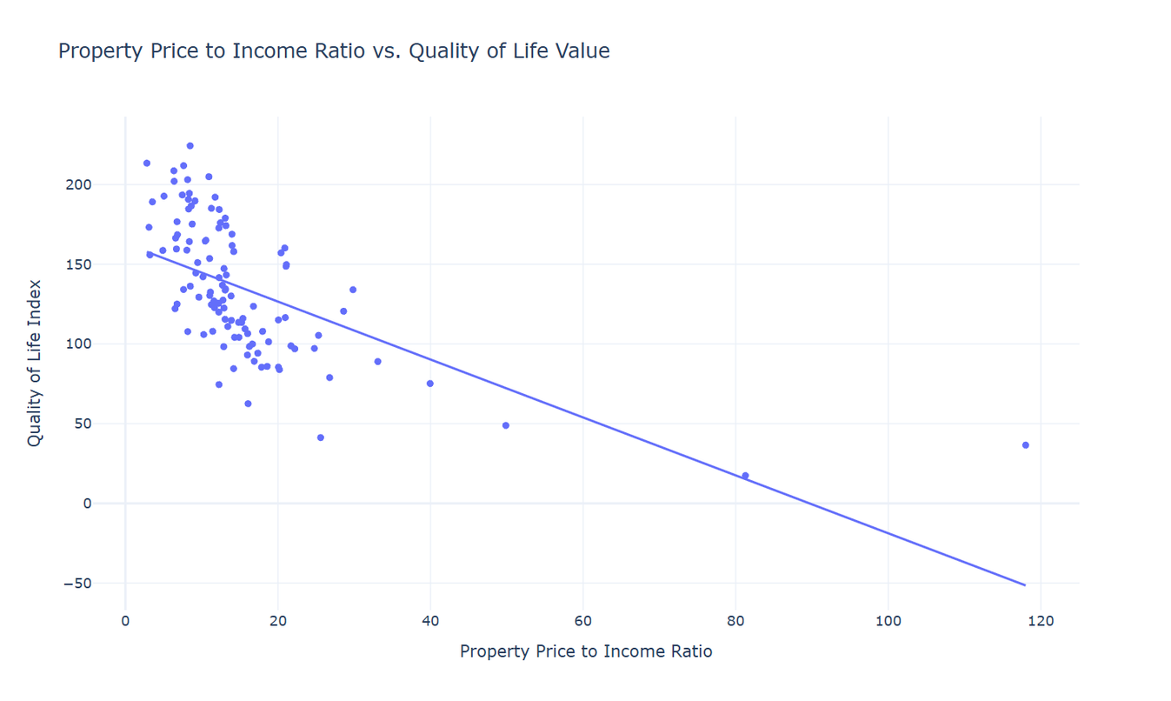
Costly housing lowers quality of life
As housing costs rise, quality of life falls
A strong negative correlation between property price-to-income ratio and quality of life across all countries.
Severe housing prices limit well-being everywhere
Notes:
Scatter plot with trend line across all countries: a strong negative correlation between Property Price-to-Income Ratio and Quality of Life Index.
3

Slide 4
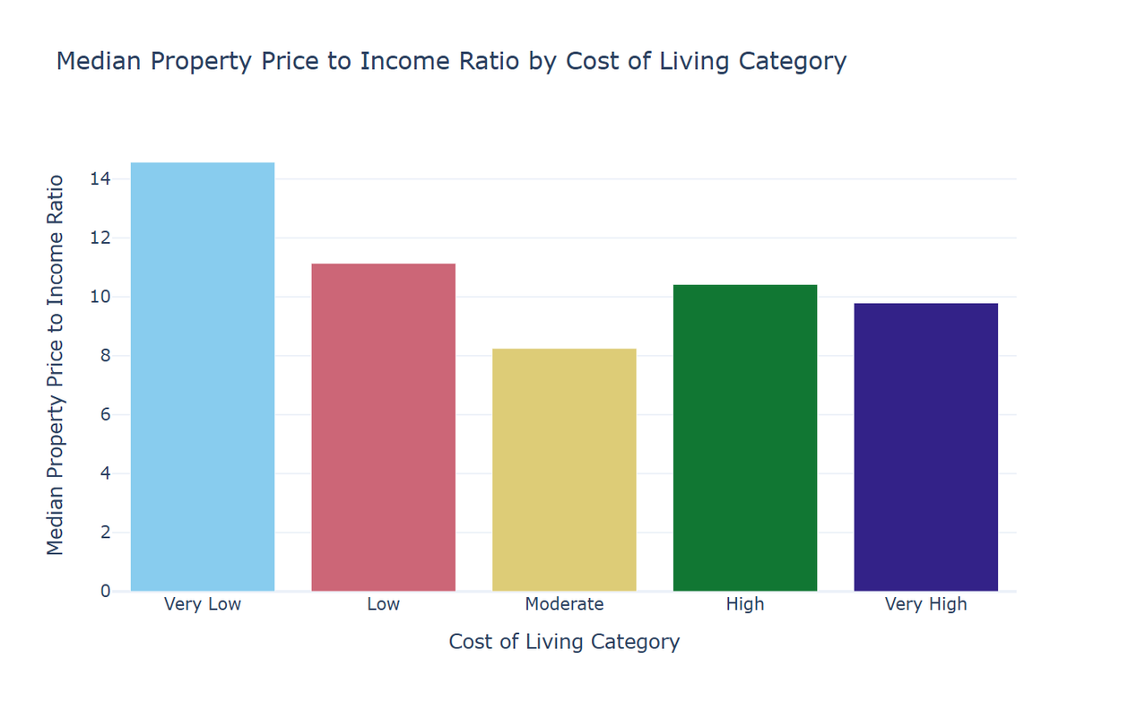
Cheap countries, costly housing
Median ratio above 14 in the cheapest countries
Very low cost-of-living countries have the highest median property price-to-income ratio of any category.
Cheap goods, low wages, expensive homes
Notes:
Very low cost-of-living nations have the highest median property price-to-income ratio, above 14. Cheap everyday goods, but wages are low relative to property prices.
4

Slide 5
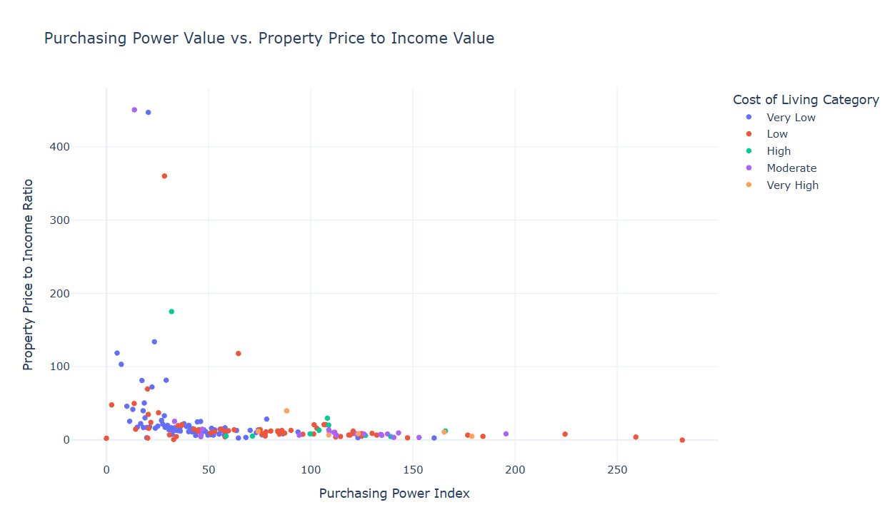
Purchasing power is the buffer
Around 100, the ratio settles below severe levels
High price-to-income ratios cluster where purchasing power is low.
Livability depends on capacity to pay, not low prices
Notes:
Once a nation's purchasing power index crosses about one hundred, the property price-to-income ratio settles below severe levels.
5

Slide 6
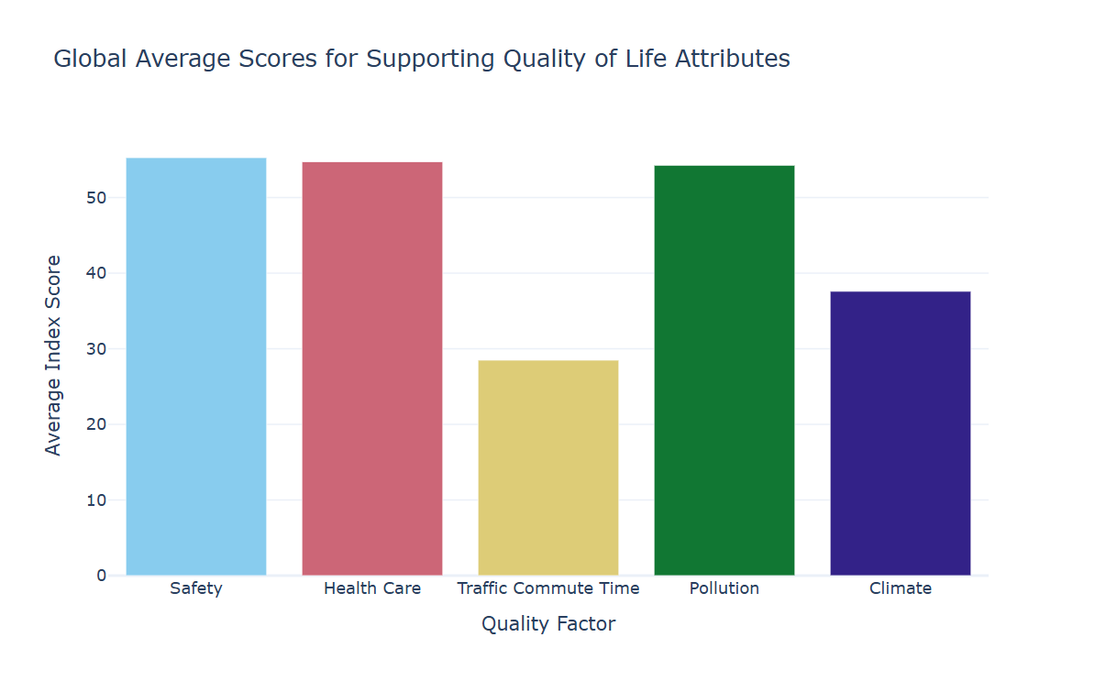
Commutes are the weakest factor
Commute score drops to about 30
Safety, health care and pollution average above 50, but traffic commute time falls far behind.
Commutes drag down daily life
Notes:
The global average of supporting factors is high, but traffic commute time drops to about 30. Workers are pushed into long commutes by expensive urban housing, which weighs on daily quality of life even where health care and safety are good.
6

Slide 7
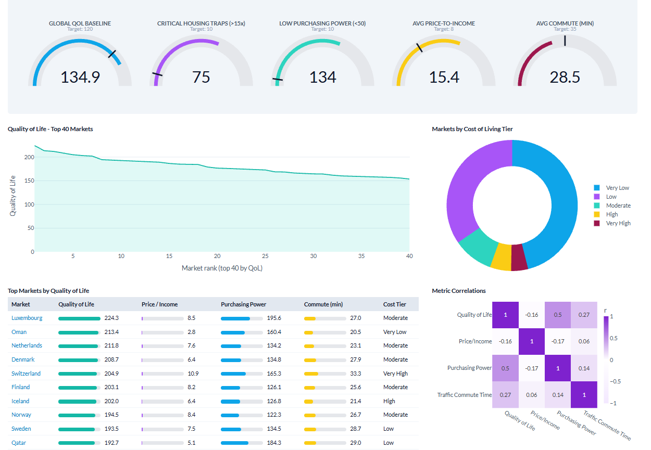
Socioeconomic Informative Dashboard
Notes:
Live demo of the Socioeconomic Interactive Dashboard: let migrants, families and workers compare countries on housing ratio, purchasing power, cost of living and quality of life before they relocate.
7

Slide 8
What this means for decisions
The cheapest countries often have the costliest housing.
1
Purchasing power drives real livability.
2
Choose places that are livable, not just cheap.
3
Commutes remain the weakest everyday factor (score of about 30), even where health care and safety score well.
Notes:
Traditional cost-of-living metrics are misleading for financial and migration planning. The real drivers are purchasing power and the property price-to-income ratio.
6

Slide 9


Slide 10


Slide 11



Team 6
Bienvenido B. Pangilinan Jr.
Al Twain D. Pasion
Carl Andrei D. Torres
Data collection, slides, documentation, presenter
System design, data collection
Data collection, slides, documentation, presenter
Submitted to Engr. Jimlord Quejado
Sources: Mohamed, A. (2025). Quality of life for each country. Kaggle. | Saiz, A. (2023). The Global Housing Affordability Crisis. SSRN.
Notes:
Pasion led system design and coding. Pangilinan and Torres handled the slides, documentation and presentation. All three collected data. Full references: Mohamed (2025), Kaggle; Saiz (2023), SSRN, https://doi.org/10.2139/ssrn.4402329
7

